Slide 1
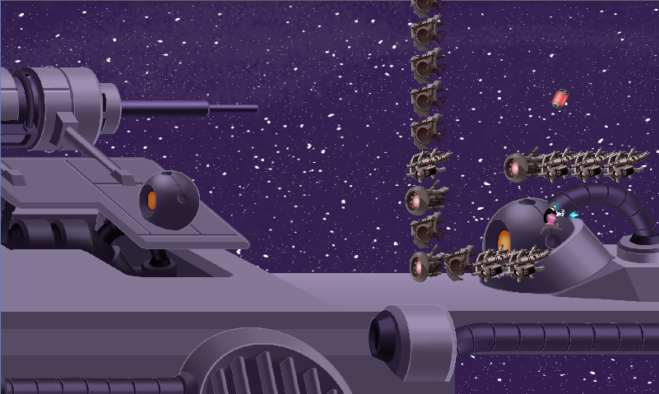
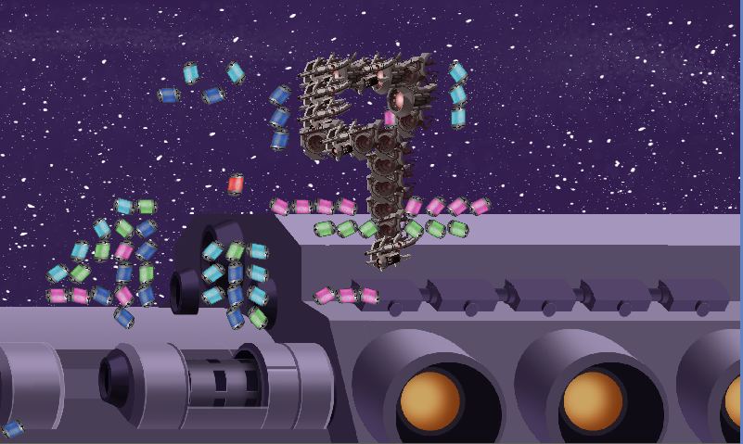






Educational Game API
Presentation: Holden Woelfl – Advisor: Kelvin Sung – Sponsor: Rob Nash – Summer 2016
Intro
Solution
Result
A programming API for educational purposes
Part of an effort to bring programming education to younger generations of students
A procedural API will be created based off of the codebase of an existing game
Base game will be Dye Hard, a game produced by students in UW’s Game-Themed Research Group
Base game engine operates on an event-driven, object-oriented structure
Procedural API will provide a library of wrapper functions as a layer of abstraction
A set of demos and labs will be created to demonstrate the the API
The demos and labs will also serve as a way of testing the usability of the API
An API library has been created, providing the simplified interface for programming games
A set of labs has been created, for educating novice programmers on programming with the API
A set of demos has been created to illustrate the use of API functions to experienced programmers
Problem
Writing programs is involved and complex
In order to learn these skills, interest is important
Many young minds are captivated by video games
Video games have complex inner systems, which present a steep implementation challenge
A simplified interface for programming video games is needed
Application
Used in a UW-hosted summer camp to teach young, aspiring programmers the basics of writing code
Object-Oriented
Interface
(Functions are associated with objects)
Procedural
Interface
(Functions stand alone)
Conclusions
Testing for usability is very important when designing interfaces
When a group shares an inherited codebase for separate projects, changes to the original code should be done cautiously
Tools used:

